Slide 1
Generalized Group Lasso for Predictive Biomarker Identification
Wenxuan Deng
Working with Kevin Galinsky and Jacob Zhang

Slide 2
Outline
Background:
What is predictive biomarker?
Variable Selection with Lasso
Model:
Linear model
Group Lasso penalty term design
Simulations
Proportions of nonzero interactions
Signal to Noise ratio
Large-scale high dimensional data
Conclusions

Slide 3
Background

Slide 4
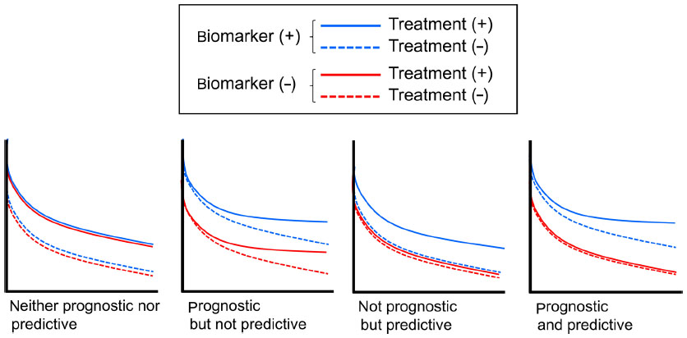
Predictive Biomarkers and Prognostic Biomarkers
Mukohara, Toru. Breast Cancer: Targets and Therapy 7 (2015)

Slide 5
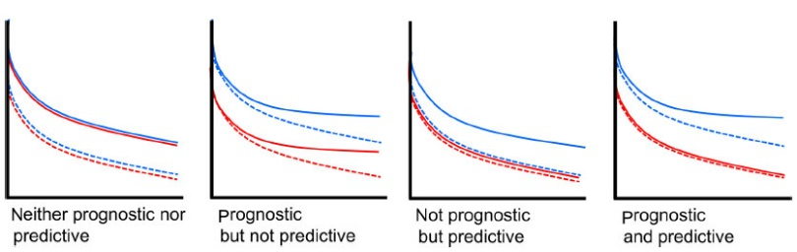

Slide 6
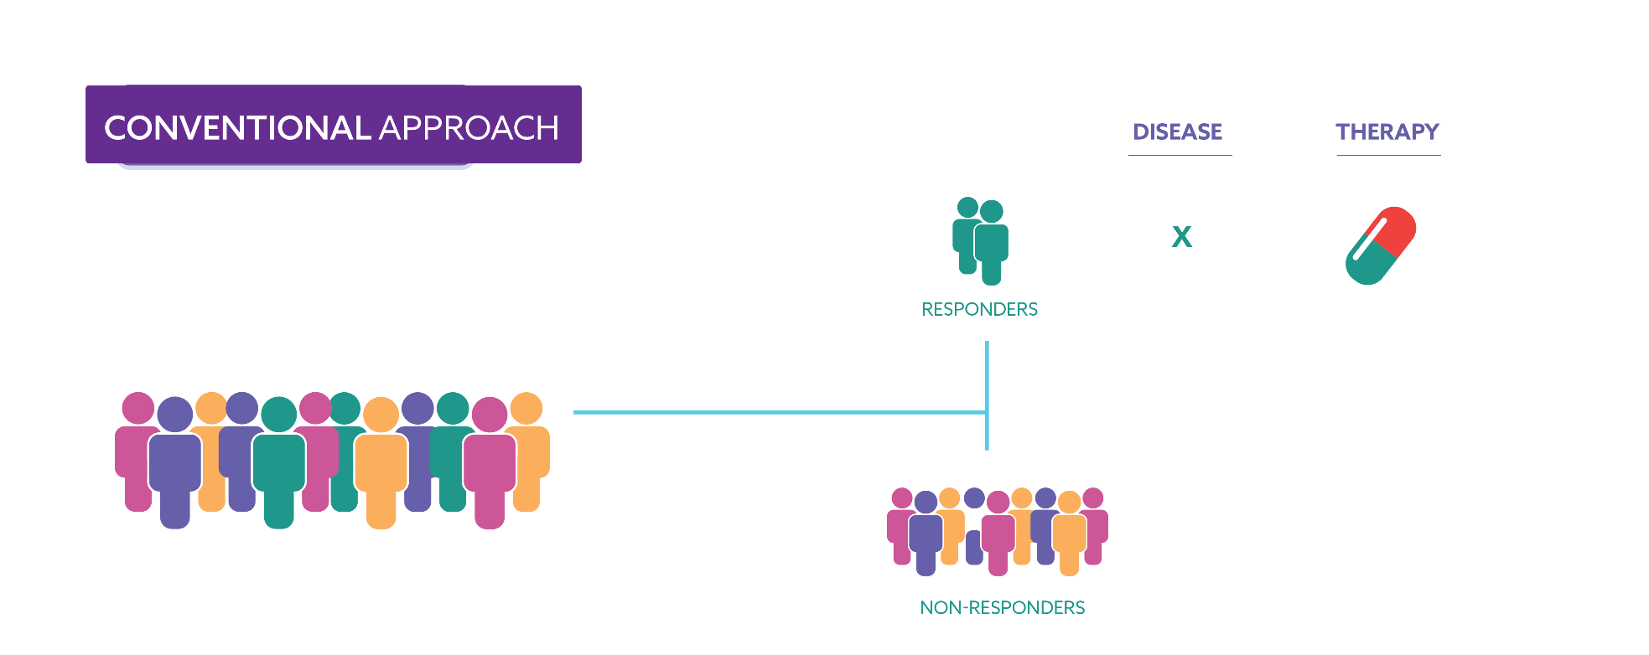
Patient Subgroup Identification
X
X

Slide 7
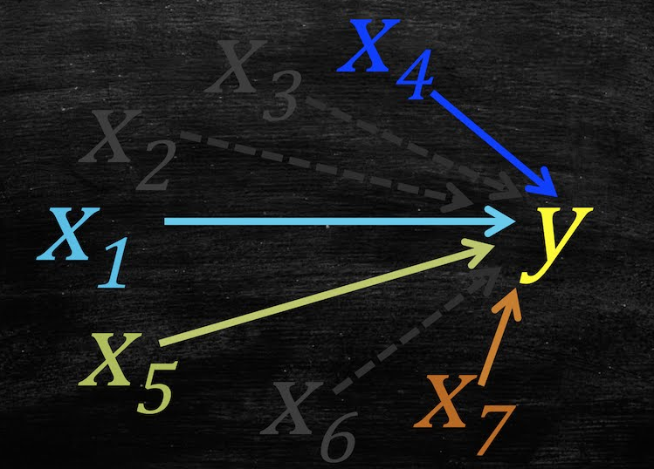
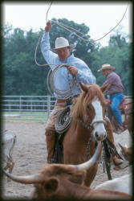
Variable Selection
Lasso
Least Absolute Shrinkage and Selection Operation

Slide 8
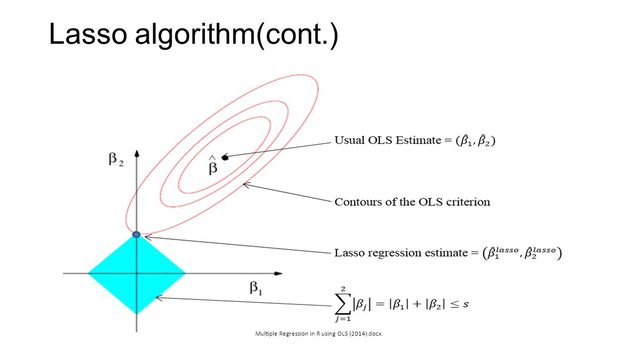

Lasso
Penalization
$\min_{β}\frac{1}{2}∥Y−Xβ∥^{2}$ $+λ{\left|β\right|}_{1}$
$$\min_{β}\frac{1}{2}∥Y−Xβ∥^{2}$$
$$s.t. {\left|β\right|}_{1}<t$$

Slide 9
Model

Slide 10
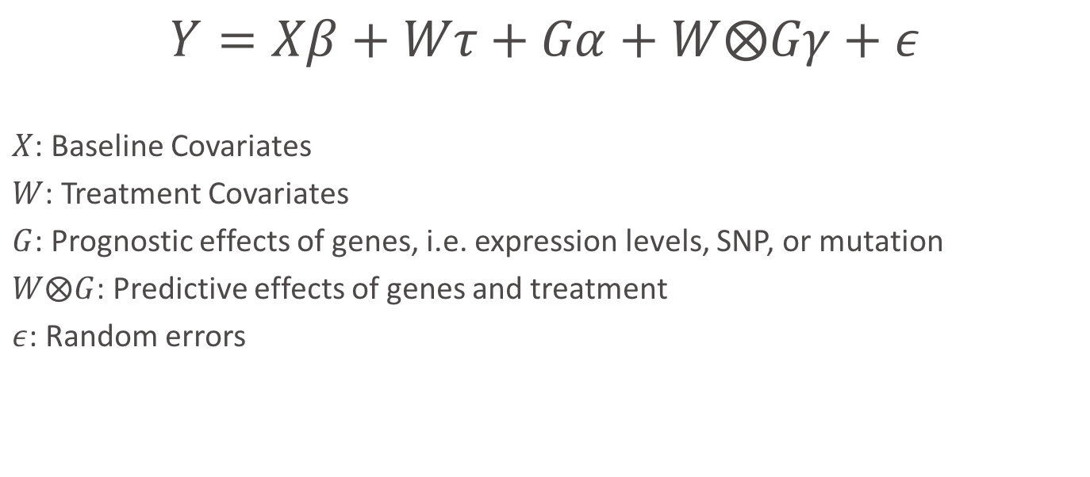
Model
$$Y=Xβ+Wτ+Gα+W⨂Gγ+ε$$
$X$: Baseline Covariates
$W$: Treatment Covariates
$G$: Prognostic effects of genes, i.e. expression levels, SNP, or mutation
$W⨂G$: Predictive effects of genes and treatment
$ε$: Random errors

Slide 11
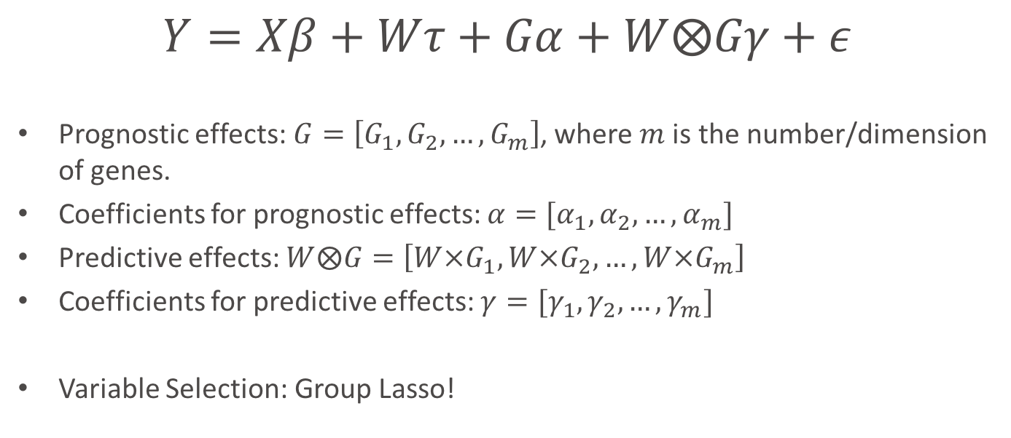
Model
$$Y=Xβ+Wτ+Gα+W⨂Gγ+ε$$
Prognostic effects: $G=\left[G_{1},G_{2},…, G_{m}\right]$, where $m$ is the number/dimension of genes.
Coefficients for prognostic effects: $α=[α_{1},α_{2},…, α_{m}]$
Predictive effects: $W⨂G=\left[W×G_{1},W×G_{2},…,W×G_{m}\right]$
Coefficients for predictive effects: $γ=[γ_{1},γ_{2},…, γ_{m}]$
Variable Selection: Group Lasso!

Slide 12
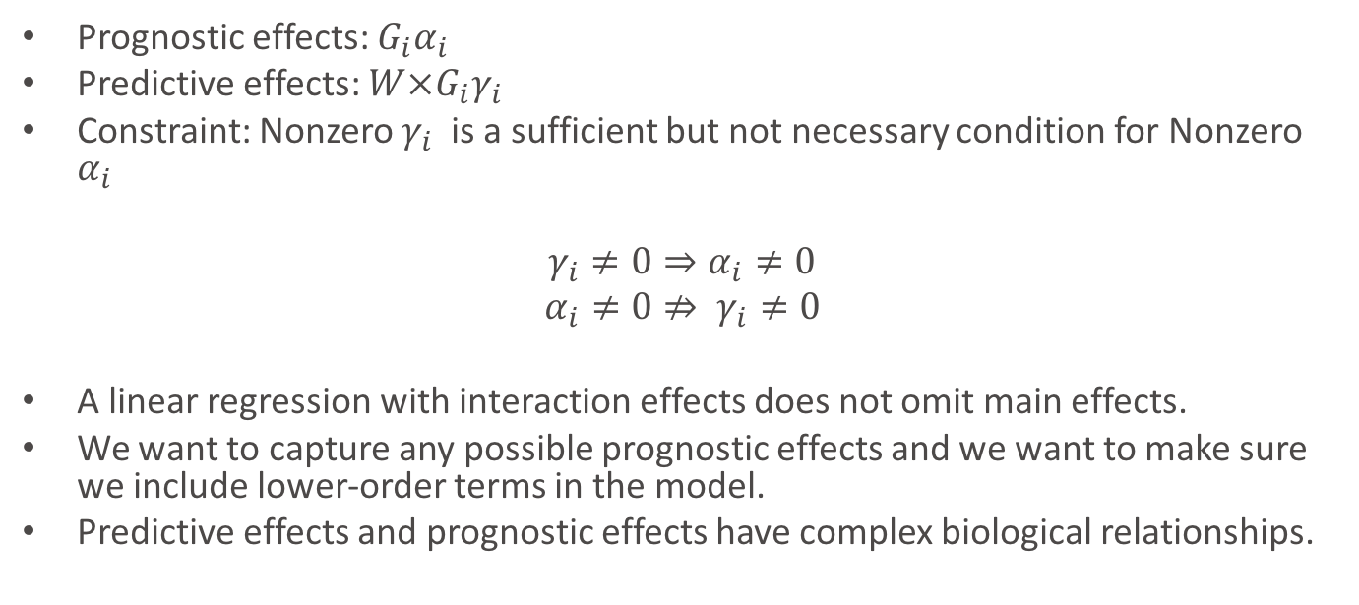
Hierarchical Structure Constraint
Prognostic effects: $G_{i}α_{i}$
Predictive effects: $W×G_{i}γ_{i}$
Constraint: Nonzero $γ_{i}$is a sufficient but not necessary condition for Nonzero $α_{i}$
$γ_{i}≠0⇒α_{i}≠0$
$$α_{i}≠0⇏ γ_{i}≠0$$
A linear regression with interaction effects does not omit main effects.
We want to capture any possible prognostic effects and we want to make sure we include lower-order terms in the model.
Predictive effects and prognostic effects have complex biological relationships.

Slide 13
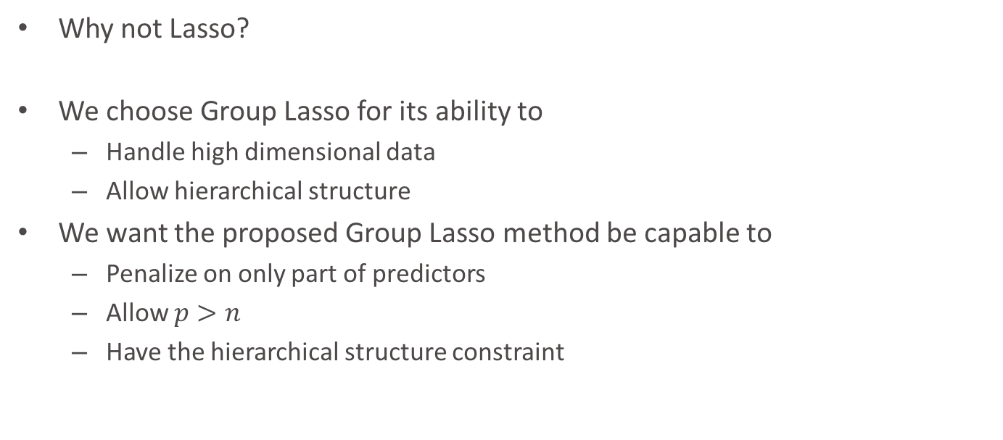
Group Lasso
Why not Lasso?
We choose Group Lasso for its ability to
Handle high dimensional data
Allow hierarchical structure
We want the proposed Group Lasso method be capable to
Penalize on only part of predictors
Allow $p>n$
Have the hierarchical structure constraint

Slide 14
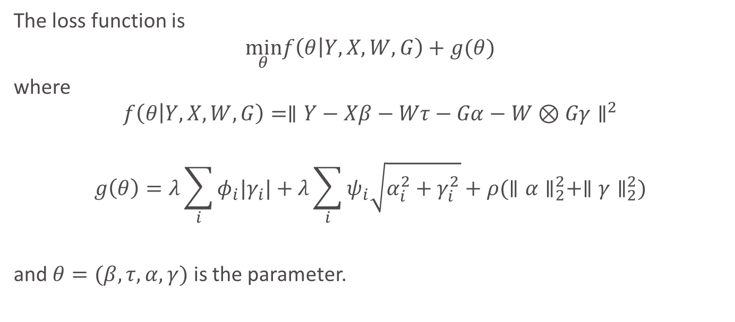
Loss Function
The loss function is
$$\min_{θ}f\left(θ | Y,X,W,G\right)+g(θ)$$
where
$$f\left(θ | Y,X,W,G\right)=∥Y−Xβ−Wτ−Gα−W⊗Gγ∥^{2}$$
$$g\left(θ\right)=λ\sum_{i}{φ_{i}|γ_{i}|}+λ\sum_{i}{ψ_{i}\sqrt{α_{i}^{2}+γ_{i}^{2}}+ρ(∥α∥_{2}^{2}+∥γ∥_{2}^{2})}$$
and $θ=(β,τ,α,γ)$ is the parameter.
Group Lasso Structure
Ridge Structure
Regularization
Parameter

Slide 15
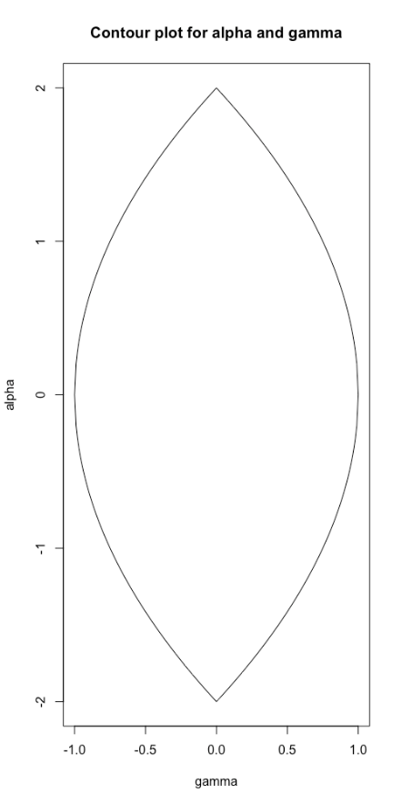

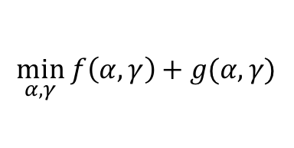



Geometrical Interpretation of Group Lasso Structure
$$γ=0, α≠0$$
Convex function $f(α,γ)$
$$\min_{α,γ} f\left(α,γ\right)+g(α,γ)$$
$$g\left(α,γ\right)=\left|γ\right|+\sqrt{α^{2}+γ^{2}}$$
$$γ≠0, α≠0$$

Slide 16
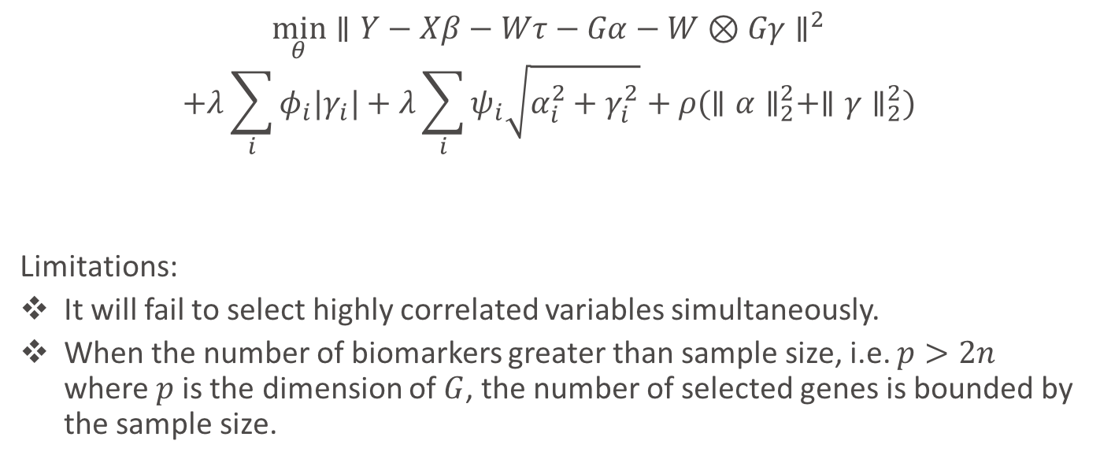
If Without Ridge Structure…
$$\min_{θ}∥Y−Xβ−Wτ−Gα−W⊗Gγ∥^{2}$$
$$+λ\sum_{i}{φ_{i}|γ_{i}|}+λ\sum_{i}{ψ_{i}\sqrt{α_{i}^{2}+γ_{i}^{2}}}+ρ(∥α∥_{2}^{2}+∥γ∥_{2}^{2})$$
Limitations:
It will fail to select highly correlated variables simultaneously.
When the number of biomarkers greater than sample size, i.e. $p>2n$ where $p$ is the dimension of $G$, the number of selected genes is bounded by the sample size.

Slide 17
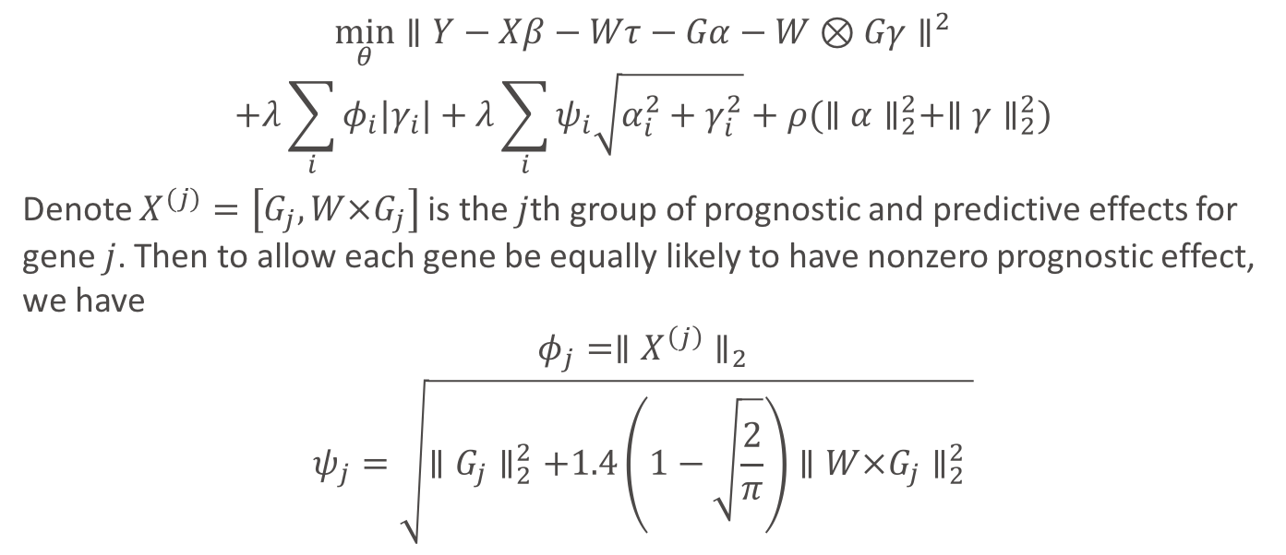
Adaptive Weights
$$\min_{θ}∥Y−Xβ−Wτ−Gα−W⊗Gγ∥^{2}$$
$$+λ\sum_{i}{φ_{i}|γ_{i}|}+λ\sum_{i}{ψ_{i}\sqrt{α_{i}^{2}+γ_{i}^{2}}}+ρ(∥α∥_{2}^{2}+∥γ∥_{2}^{2})$$
Denote $X^{(j)}=\left[G_{j},W×G_{j}\right]$ is the $j$th group of prognostic and predictive effects for gene $j$. Then to allow each gene be equally likely to have nonzero prognostic effect, we have
$$φ_{j}=∥X^{\left(j\right)}∥_{2}$$
$$ψ_{j}=\sqrt{∥G_{j}∥_{2}^{2}+1.4\left(1−\sqrt{\frac{2}{π}}\right)∥W×G_{j}∥_{2}^{2} }$$
Adaptive Weight

Slide 18
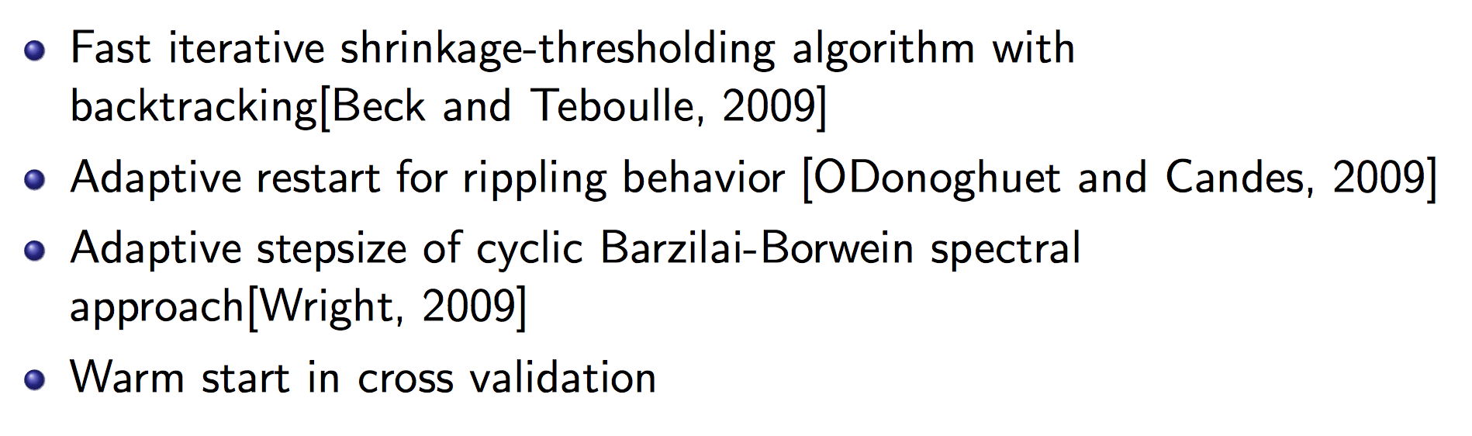
Optimization Strategies

Slide 19
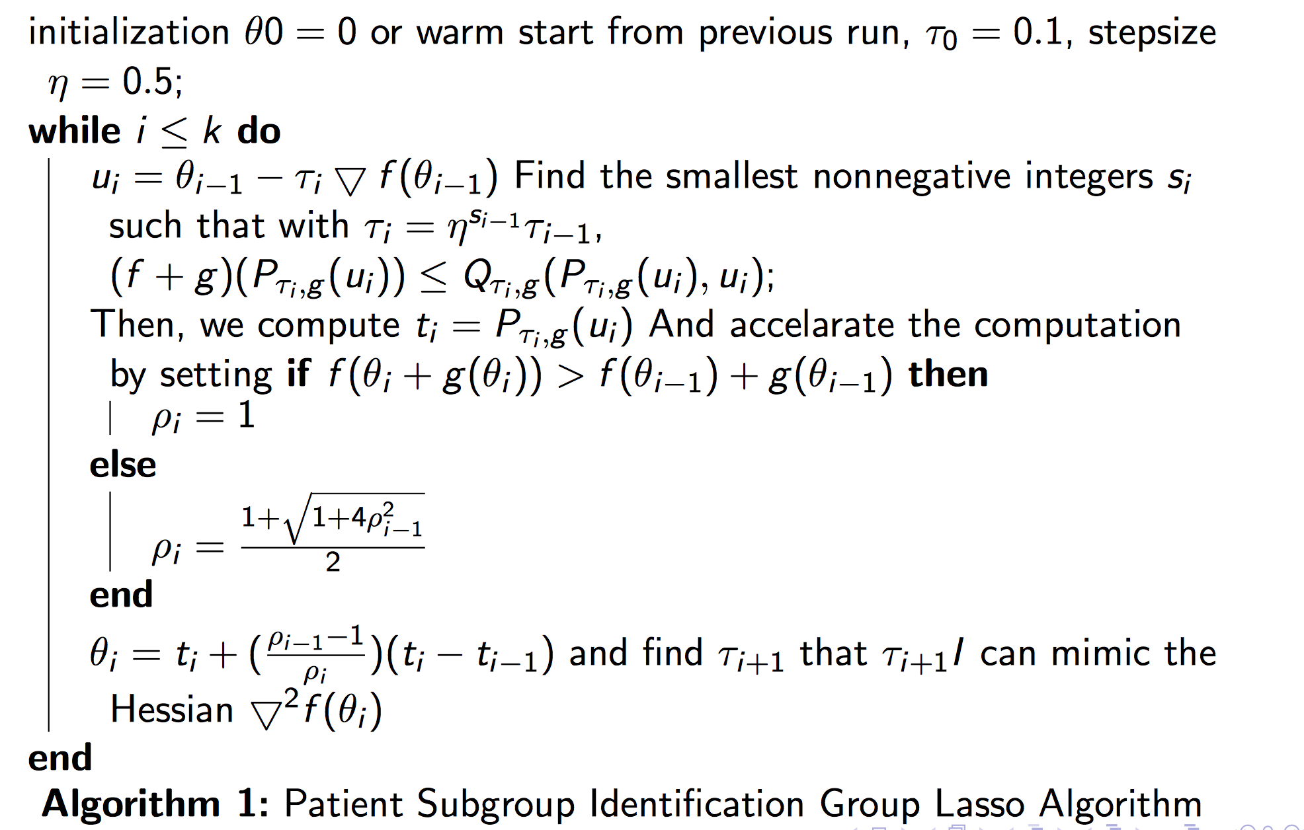
Algorithm

Slide 20
Simulations

Slide 21
Simulation Setup
N=100
Dimensions for baseline covariates = 5 (Standard Normal Distribution)
Dimensions for treatment covariate = 1, (binary: +1,-1)
Dimensions for Genes = 50, 100,200 (Standard Normal Distribution/Binomial Distribution)
Coefficients for baseline and treatment variables: standard normal distribution
Coefficients for genes=+3,-3,+5,-5

Slide 22

Simulation Setup
5%, 10%, 15%, 20% of genes have predictive effects
10%, 20%, 30%, 40% of genes have prognostic effects
Iterations: 100
Prognostic Effects
40%
Predictive Effects
20%
$m$ genes

Slide 23
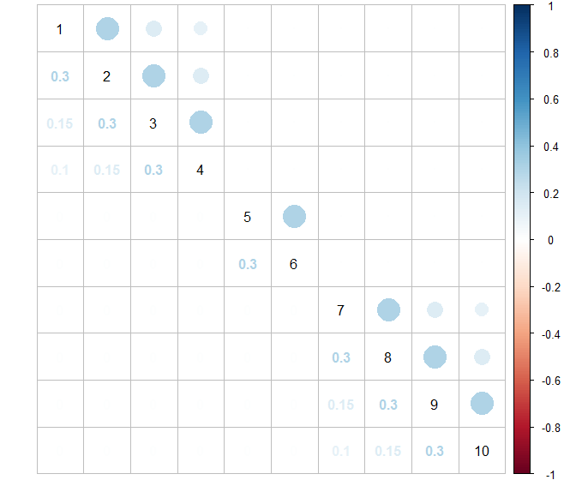
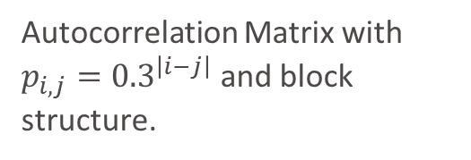
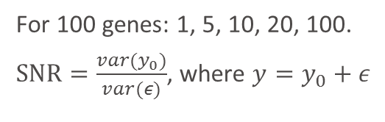
Correlation Structure
Simulation Setup
Autocorrelation Matrix with $p_{i,j}={0.3}^{\left|i−j\right|}$ and block structure.
Signal to Noise ratio (SNR)
For 100 genes: 1, 5, 10, 20, 100.
$SNR=\frac{var(y_{0})}{var(ε)}$, where $y=y_{0}+ε$

Slide 24
Fixed number of genes: 100
Fixed SNR=10
SNR
Fixed number of genes: 100
Fixed covariates data type: Standard Normal Distribution
Fixed covariates data type: Standard Normal Distribution
Dimension
Fixed proportion of nonzero predictive biomarkers: 10%
Fixed SNR=10
Fixed covariates data type: Standard Normal Distribution
SNP
Proportion
Fixed proportion of nonzero predictive biomarkers: 10%
Fixed number of genes: 100
Fixed proportion of nonzero predictive biomarkers: 10%
Fixed SNR=10

Slide 25
Other methods
General Elastic Net without penalizing baseline and treatment variables (Lasso)
Bayesian Model Averaging (BMA)
Stepwise Variable Selection by likelihood (step)
Iterative Sure Independent Screening (SIS)
Random Forest

Slide 26
Proportion of nonzero interactions
Fixed number of genes: 100
Fixed SNR=10
Fixed covariates data type: Standard Normal Distribution

Slide 27
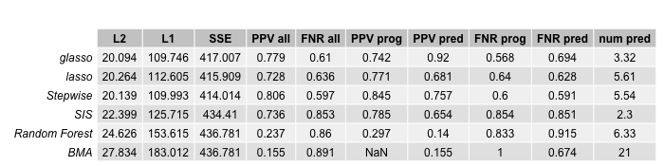
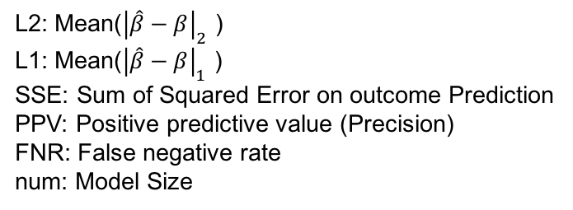
Nonzero Interaction Effects Proportion=5%
L2: Mean(${\left|\hat{β}−β\right|}_{2}$ )
L1: Mean(${\left|\hat{β}−β\right|}_{1}$ )
SSE: Sum of Squared Error on outcome Prediction
PPV: Positive predictive value (Precision)
FNR: False negative rate
num: Model Size

Slide 28
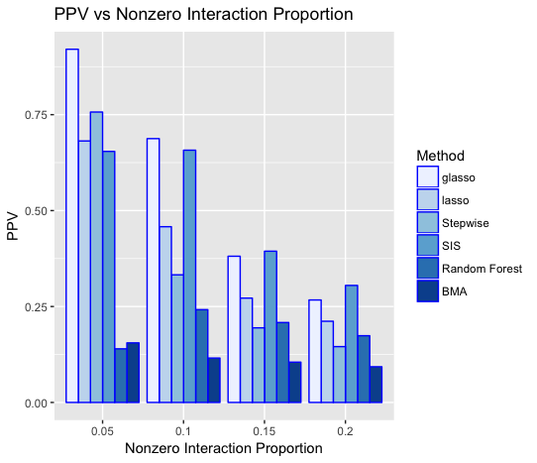
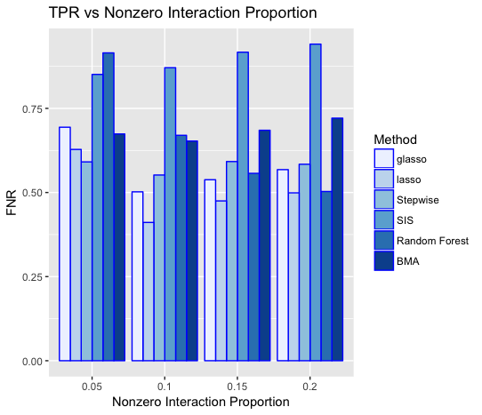

Slide 29
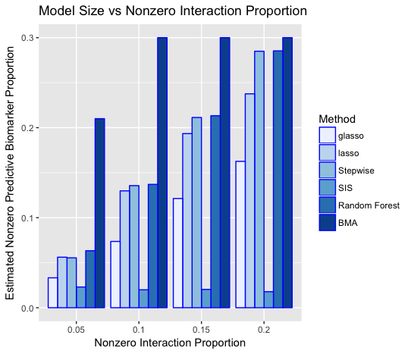
Group Lasso has the highest precision.
Precision decreases as proportion of nonzero biomarkers increasing.
Group Lasso has an relative low FNR.
Group Lasso underestimated model size for predictive biomarkers.
Currently developing new stop criterion to reduce FNR.

Slide 30
Signal to Noise Ratio (SNR)
Fixed number of genes: 100
Fixed proportion of nonzero predictive biomarkers: 10%
Fixed covariates data type: Standard Normal Distribution

Slide 31
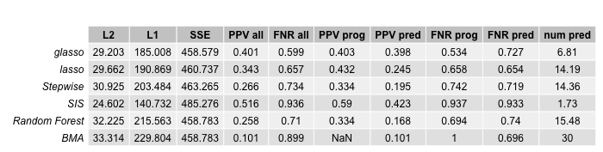
SNR=1
L2: Mean(${\left|\hat{β}−β\right|}_{2}$ )
L1: Mean(${\left|\hat{β}−β\right|}_{1}$ )
SSE: Sum of Squared Error on outcome Prediction
PPV: Positive predictive value (Precision)
FNR: False negative rate
num: Model Size

Slide 32
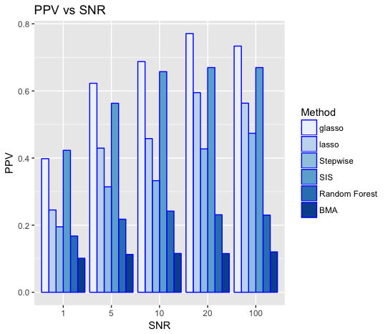
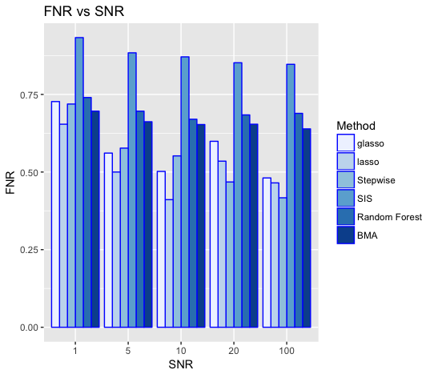

Slide 33
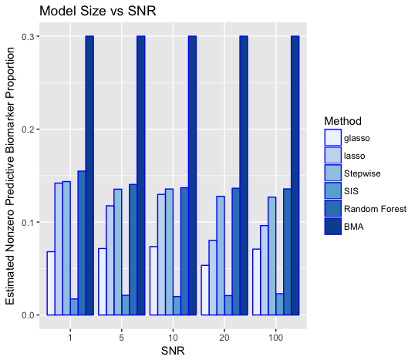
Group Lasso has the highest precision.
Precision increases as signal being stronger.
Group Lasso has an relative low FNR.
Group Lasso underestimated model size for predictive biomarkers.
Currently developing new stop criterion to reduce FNR.

Slide 34
Other number of biomakers
Fixed SNR=10
Fixed proportion of nonzero predictive biomarkers: 10%
Fixed covariates data type: Standard Normal Distribution

Slide 35
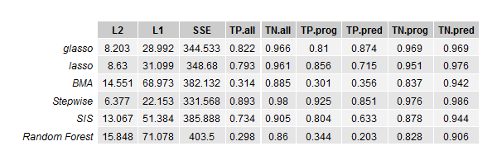
Dimension of genes=50 and total dimension=106

Slide 36
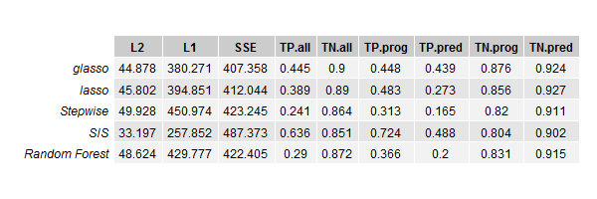
Dimension of genes=200 and total dimension=406

Slide 37
When covariates are SNP
Fixed number of genes: 100
Fixed proportion of nonzero predictive biomarkers: 10%
Fixed SNR=10

Slide 38
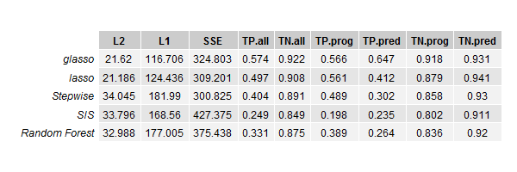
SNP

Slide 39
Conclusions
Group Lasso has the highest precision in all different scenarios.
Precision decreases as proportion of nonzero biomarkers increasing.
Precision increases as signal being stronger.
Group Lasso has an relative low FNR.
Group Lasso underestimated model size for predictive biomarkers.

Slide 40
Future Steps
Overlapping simulations without hierarchical structure
Stop criterion
Combination of Group Lasso with other methods
Generalization on other endpoints

Slide 41
References

Slide 42
Thanks!

Slide 43
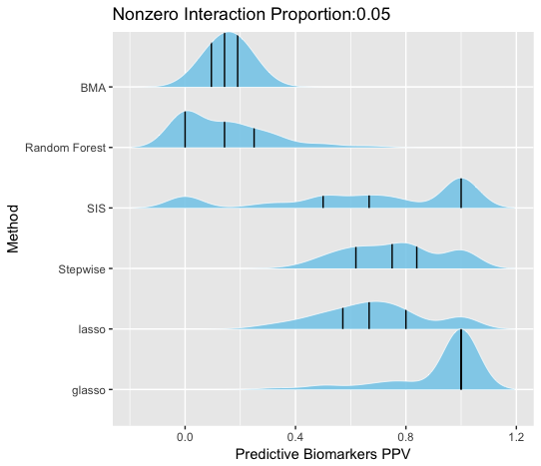
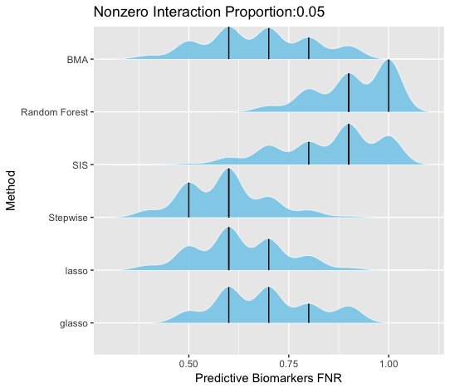

Slide 44
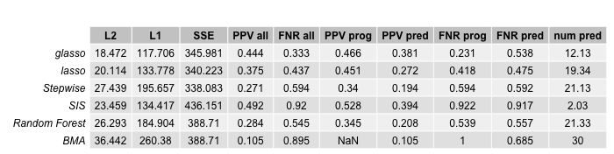
Nonzero Interaction Effects Proportion=10%
L2: Mean(${\left|\hat{β}−β\right|}_{2}$ )
L1: Mean(${\left|\hat{β}−β\right|}_{1}$ )
SSE: Sum of Squared Error on outcome Prediction
PPV: Positive predictive value (Precision)
FNR: False negative rate
num: Model Size

Slide 45
Nonzero Interaction Effects Proportion=0.15
L2: Mean(${\left|\hat{β}−β\right|}_{2}$ )
L1: Mean(${\left|\hat{β}−β\right|}_{1}$ )
SSE: Sum of Squared Error on outcome Prediction
PPV: Positive predictive value (Precision)
FNR: False negative rate
num: Model Size

Slide 46
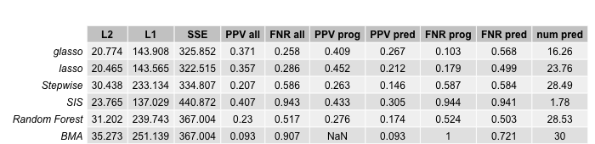
Nonzero Interaction Effects Proportion=0.2
L2: Mean(${\left|\hat{β}−β\right|}_{2}$ )
L1: Mean(${\left|\hat{β}−β\right|}_{1}$ )
SSE: Sum of Squared Error on outcome Prediction
PPV: Positive predictive value (Precision)
FNR: False negative rate
num: Model Size

Slide 47
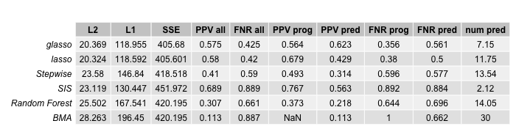
SNR=5
L2: Mean(${\left|\hat{β}−β\right|}_{2}$ )
L1: Mean(${\left|\hat{β}−β\right|}_{1}$ )
SSE: Sum of Squared Error on outcome Prediction
PPV: Positive predictive value (Precision)
FNR: False negative rate
num: Model Size

Slide 48
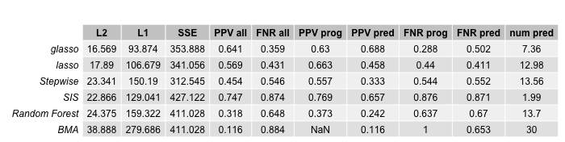
SNR=10
L2: Mean(${\left|\hat{β}−β\right|}_{2}$ )
L1: Mean(${\left|\hat{β}−β\right|}_{1}$ )
SSE: Sum of Squared Error on outcome Prediction
PPV: Positive predictive value (Precision)
FNR: False negative rate
num: Model Size

Slide 49
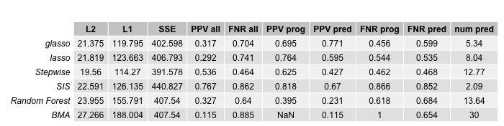
SNR=20
L2: Mean(${\left|\hat{β}−β\right|}_{2}$ )
L1: Mean(${\left|\hat{β}−β\right|}_{1}$ )
SSE: Sum of Squared Error on outcome Prediction
PPV: Positive predictive value (Precision)
FNR: False negative rate
num: Model Size

Slide 50
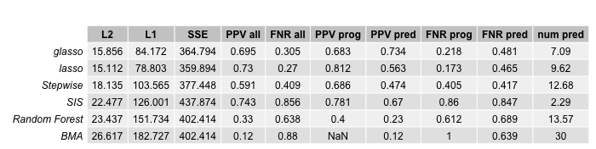
SNR=100
L2: Mean(${\left|\hat{β}−β\right|}_{2}$ )
L1: Mean(${\left|\hat{β}−β\right|}_{1}$ )
SSE: Sum of Squared Error on outcome Prediction
PPV: Positive predictive value (Precision)
FNR: False negative rate
num: Model Size

Slide 51
Real Data

